Slide 1
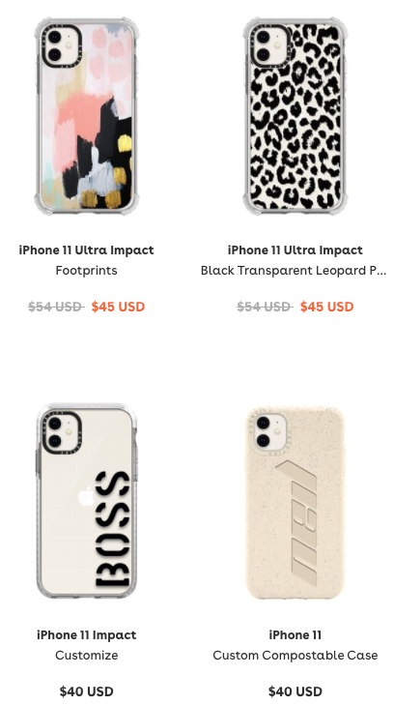
Association rule mining recommendation example
Maybe you would also like…

Slide 2
Item-item based collaborative filtering example
Kitchen set of 5 pots and 2 pans and 6 utensils and a strainer.
R$ 750,00
R$ 750,00
Have you also considered…
Chopping board
Kitchen knife
Apron
R$ 250,00
R$ 100,00
R$ 50,00

Slide 3


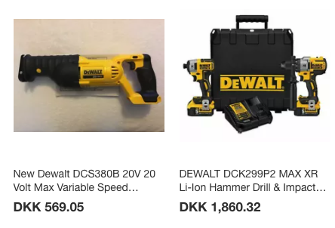
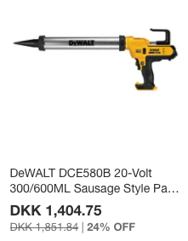
Content-based filtering example
Your personal recommendations from Olist!
Olist team <Hello@Olist.com>
To: your@email.com
Here are your personal recommendations!
Take me to my recommendations!

